Slide 1
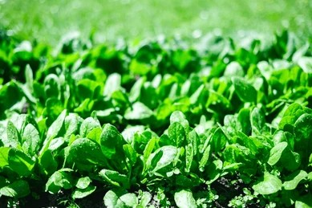
Smart Agriculture Disease Doctor
Subtitle:- Crop Disease Detection using AI & CNN
Name:- Palagani Bindu Madhavi
Class:-Btech 3rd year
Branch:-computer science and engineering
Date:-7/11/2026

Slide 2
PROBLEM STATEMENT
High Crop Loss:- Around 40% of crops in India are lost due to plant diseases every year.
Late Detection:-Farmers take 2-3 days to consult experts. By then, the disease spreads to the entire field.
Lack of Guidance:- Treatment information is mostly in English and not easily available in local languages like Telugu.
Financial Impact :-Wrong pesticides lead to extra cost and further damage to crops.
Our Solution:-An AI-powered mobile/web app that takes a photo of a crop leaf and instantly detects the disease with treatment suggestions in Telugu.

Slide 3
Objectives Of The Project
Main Goal:-To build an AI-powered system for early detection of crop diseases to help farmers increase yield and reduce losses.
Specific Objectives:-Disease DetectionDetect and classify 38 types of c crop diseases from leaf images using CNN.Multilingual Support Provide disease name and treatment suggestions in Telugu for easy understanding by farmers.
Fast & Accurate Results:-Give results within 2-3 seconds with 90%+ accuracy using MobileNetV2 model.
User-Friendly App:-Develop a simple Web App using Streamlit that works on mobile and desktop.
Reduce Crop Loss:-enable early treatment to minimize crop damage and increase farmer profit.

Slide 4
Technology Stack & Methodology
Programming Language:-Python
Deep Learning Framework:- TensorFlow & Keras
Model Used:- MobileNetV2 - CNN for image classification
Web Framework:-Streamlit for Web App interface
Dataset:-Plant Village Dataset - 54,000+ images of 38 diseases
Language Support:- Telugu for treatment suggestions

Slide 5
HOW IT WORKS - METHODOLOGY:
Input:- Farmer uploads a photo of a crop leaf
Preprocessing:- Image is resized and normalized
Prediction:- Trained CNN Model predicts the disease name
Output:-App displays Disease Name + Causes + Treatment in Telugu
Result:-Farmer takes action early to save the crop

Slide 6
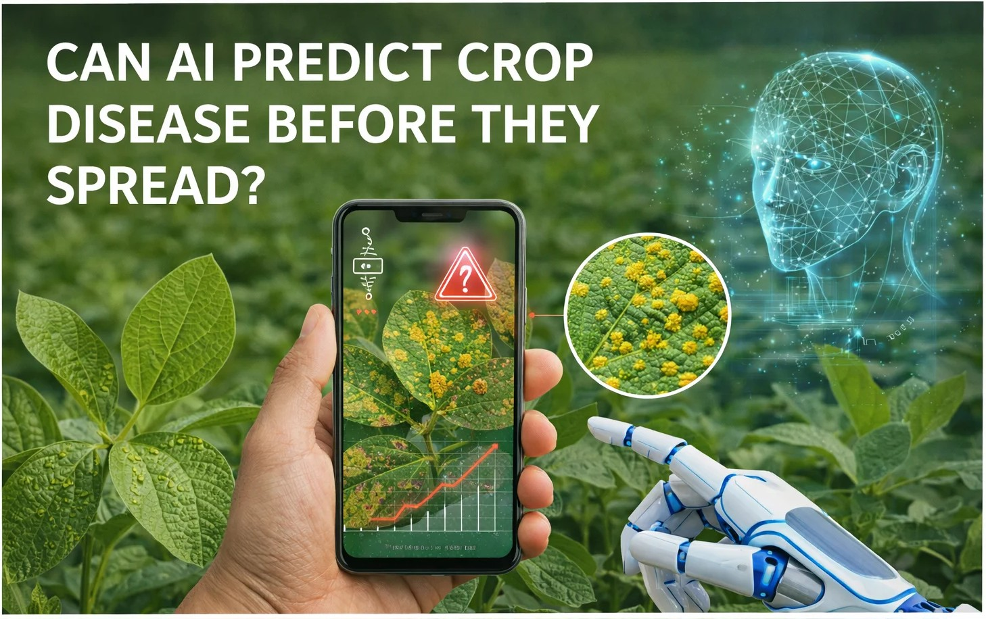
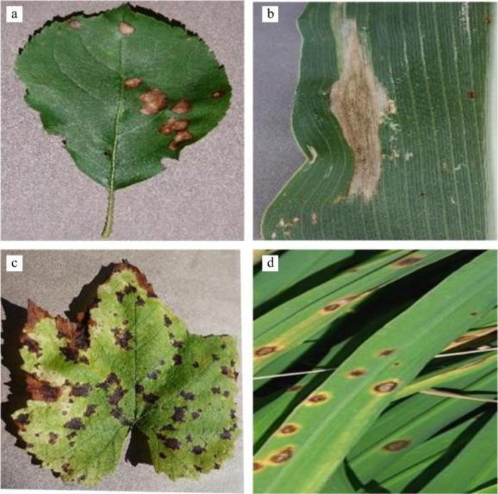
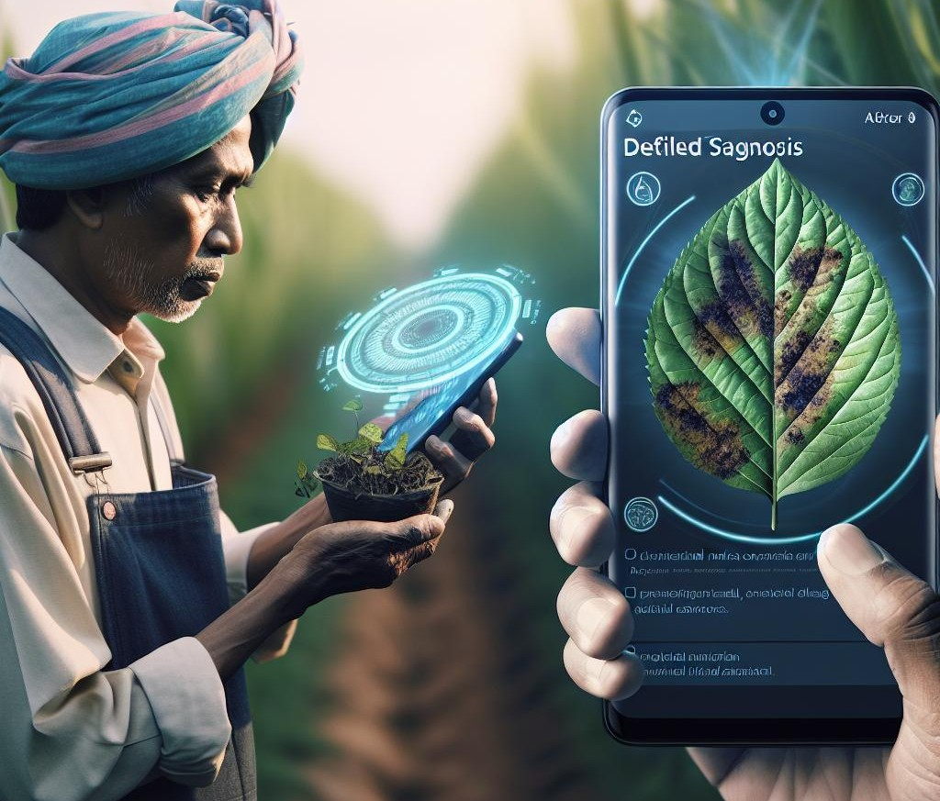
Photos on AI AGRICULTURE

Slide 7
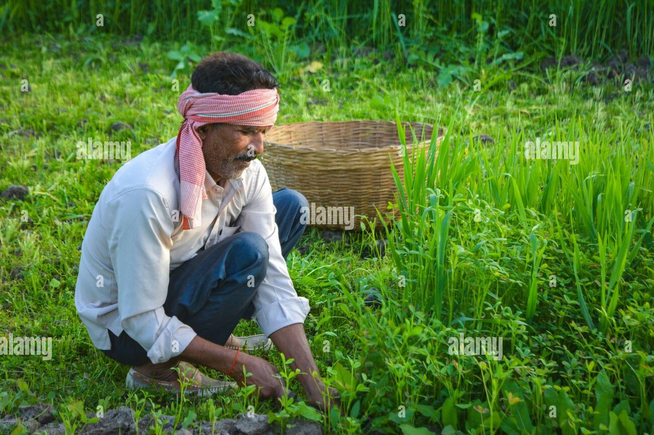
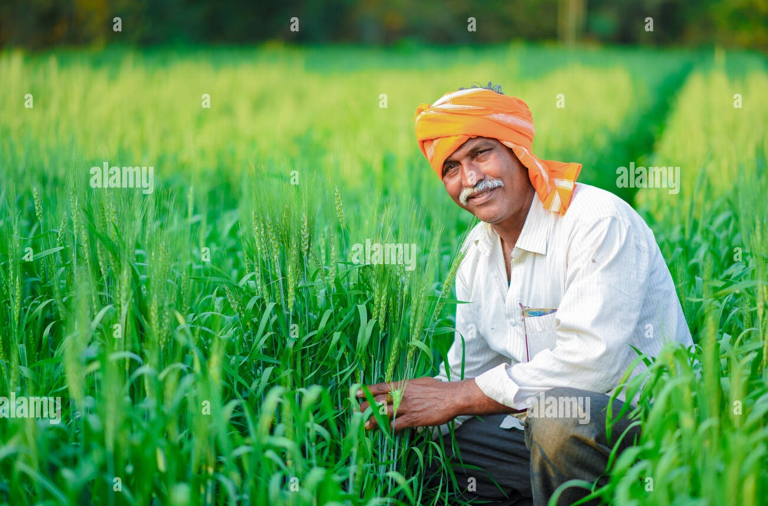
Farmers are happy to harvest crops after detecting the diseases.

